Slide 1
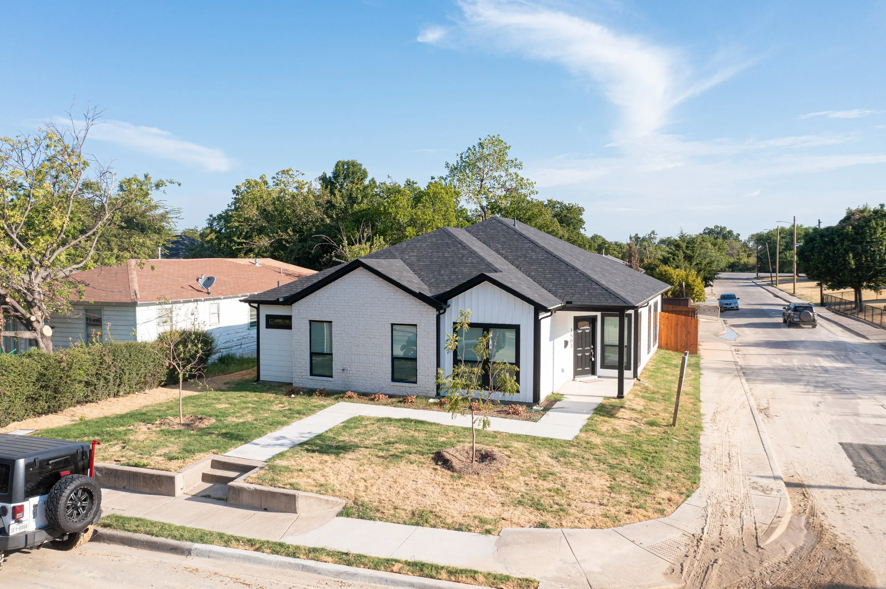
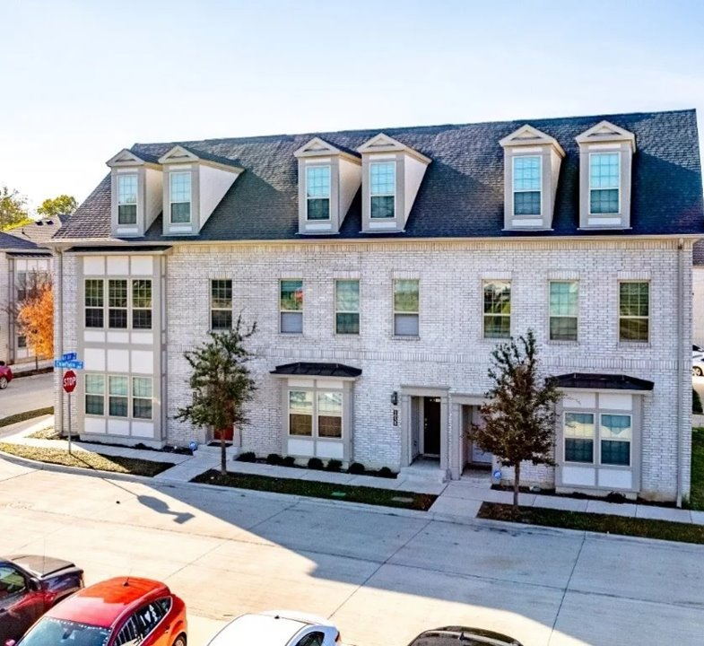
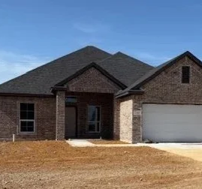
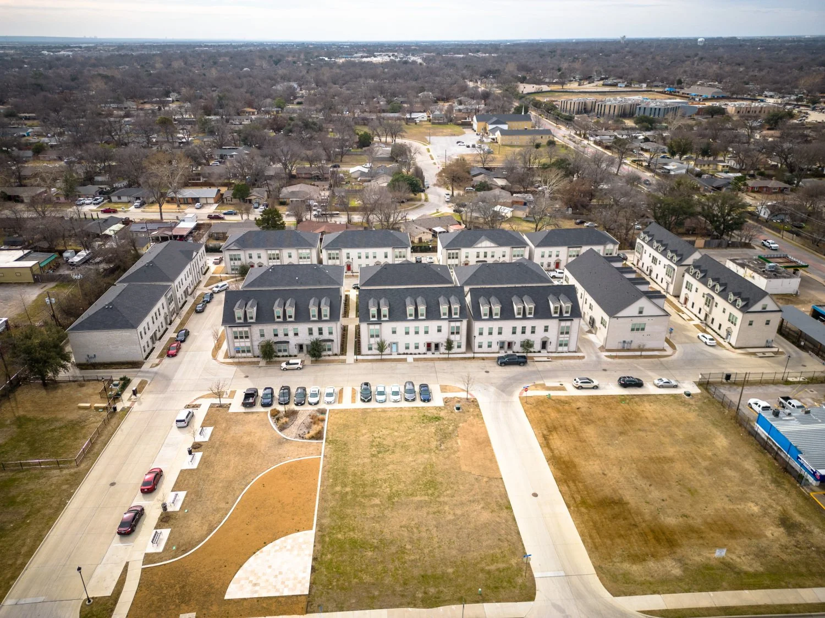
Using HOME for Single-Family Homeownership
Darwin Wade, Past NCDA Board Member
Grand Prairie, TX

Slide 2
Overview
Why homeownership remains out of reach from many LMI households?
How HOME can support single-family homeownership
Examples and best practices from NCDA communities
Lessons learned and mistakes to avoid
Notes:
Affordability Gap - Nearly 75% of U.S. households cannot afford a median-price new home in 2025 according to a 2025 Bankrate analysis 75% of U.S. homes for sale are unaffordable to typical households and a 2025 study done by the National Association of Home Builders special-study-households-priced-out-of-the-housing-market-march-2025.pdf.
Savings barrier - In 2025 average American needed about 7 years to save for a typical down payment Average Time Americans Spent Saving for a Home Down Payment in 2025 Revealed
Rising costs outpacing income growth - Home prices and mortgage rates grew much faster than income in recent years. Homeownership cost exceeds 30% of gross monthly income for many thus making it unaffordable The affordability gap: Is home ownership still within reach in today’s economy?
Geographic and market variations – market conditions vary – but affordability is widespread.
Structural inequities – Historically, low-income and minority households homeownership rates are significantly lower than other non-minority and high income groups. Even as the national homeownership rate hovers around 65%, disparities by race and income persist, showing that market forces alone are unlikely to close equity gaps without targeted policy interventions

Slide 3
Why Homeownership Is Out of Reach for Many LMI Households
75%+ of U.S. homes are unaffordable to the typical household and even higher for LMI families
Down payment savings often take 7+ years for first-time buyers
Housing costs are rising faster than incomes in most markets
LMI households and minority homeownership rates are less than higher-income and other non-minority households
Sources: Bankrate (2024–2025); NAHB; U.S. Census Bureau; Federal Reserve Bank of Atlanta; JPMorgan Chase Institute; National Association of Realtors.
Notes:
Affordability Gap - Nearly 75% of U.S. households cannot afford a median-price new home in 2025 according to National Association of Home Builders
Savings barrier - In 2025 average American needed about 7 years to save for a typical down payment
Rising costs outpacing income growth - Home prices and mortgage rates grew much faster than income in recent years. Homeownership cost exceeds 30% of gross monthly income for many thus making it unaffordable
Geographic and market variations – market conditions vary – but affordability is widespread.
Structural inequities – Historically, low-income and minority households homeownership rates are significantly lower than other non-minority and high income groups

Slide 4
HOW HOME Supports Homeownership
Closes development and financing gaps
Acquisition, new constructions, and rehabilitation
Reduced upfront costs for buyers
Down payment and closing cost assistance
Buyer subsidies tied to affordability periods
Leverage strategic partnerships
For-profit and nonprofit developers
Community Housing Development Organizations (CHDOs)
HUD-approved counseling agencies
Land banks and land transfer programs
Community Land Trusts
Faith-Based Organizations with vacant or underutilized land
Public housing authorities
School districts and universities

Slide 5
Funding Source Partners
HOME funds are most effective when leveraged with partners who bring capital to the table:
Developers (for-profit & nonprofit)
Equity and project sponsorship
Lenders
Construction and permanent financing
Philanthropic and Impact Investments
Program-related investments, grants, soft capital
Housing Finance Agencies
Bond financing and Low Income Housing Tax Credits (LIHTCs)
Community Development Financial Institutions (CDFIs)
Flexible, mission-driven lending

Slide 6
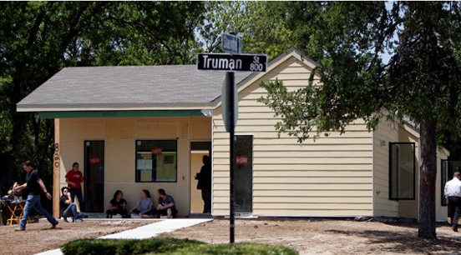
Examples and Best Practices From NCDA Communities Housing Channel (CHDO) & University of Texas at Arlington

Slide 7
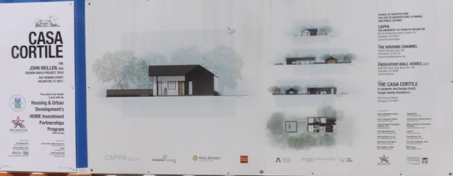
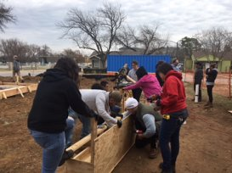
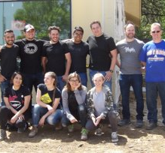
CHDO & University Partnership

Slide 8
New Single-Family Housing
47 Townhomes
Three commercial sites
21,000 sq. ft. of greenspace
Notes:
Bel Air on Abram is a mixed-use, mixed-income residential development in East Arlington, located one mile from the Arlington Entertainment District. Built on 4.4 acres formerly occupied by aging housing stock in an area originally developed in mid-century as housing for General Motors employees (the community’s name is a nod to the iconic Chevrolet Bel Air once produced at the plant), the stylish development includes 47 single-family townhomes, three commercial sites, and over 21,000 square feet of green space designed to enhance walkability and neighborhood character.​
The $9 million residential project was financed through a combination of $4 million in New Markets Tax Credits and $5 million in private funding. Homes were priced between $195,000 and $360,000, with income-eligible buyers receiving up to $45,000 in down payment assistance to support long-term affordability and homeownership.​
​

Slide 9
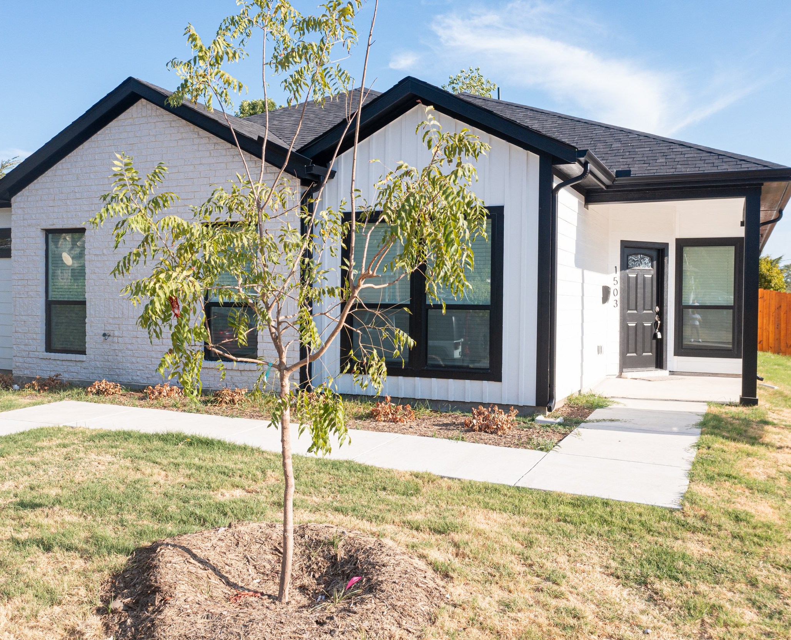
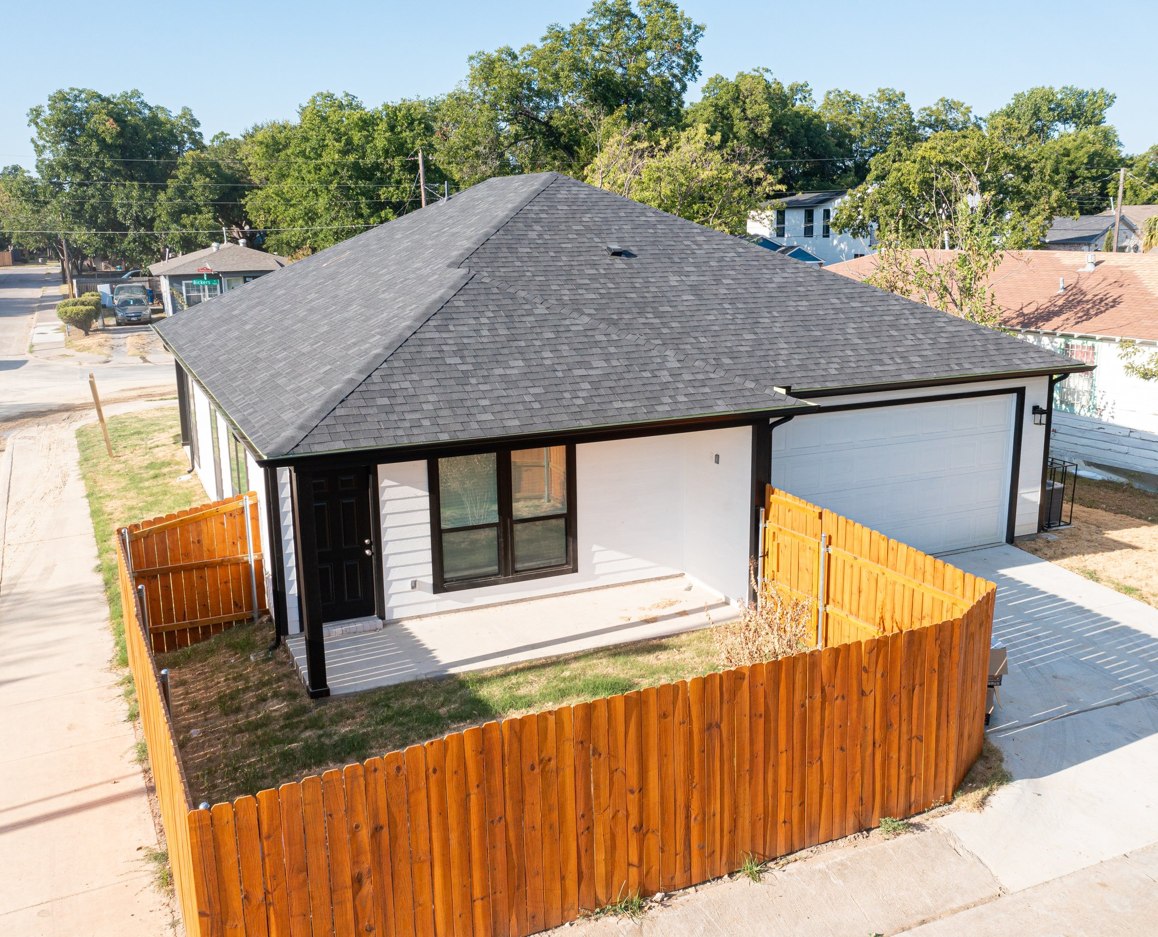
West Dallas Revitalization Project Builders of Hope CDC (CHDO) 20 City Land Transfer Infill lots sold below market All HOME-assisted homes sold to 60-80% AMI households Sales price mid $200k
Notes:
Each thoughtfully designed home features spacious layouts of 1,300-1,700 livable square feet with 3-4 bedrooms and 2-2.5 bathrooms, including walk-in showers and closets. The open floor plans create bright, flowing living spaces, while a 2-car
garage provides ample parking. All homes come fully equipped with kitchen appliances including stove, dishwasher, refrigerator, and microwave.
City provided CHDO $860k in HOME developer subsidy ($43k per lot and up to $50k in down payment assistance) with sales price of mid $200k

Slide 10
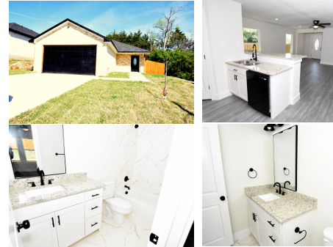
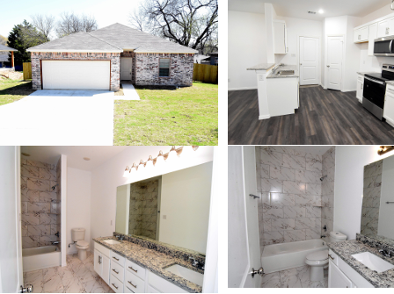
Five Mile Neighborhood Infill Project Notre Dame Place, Inc (CHDO) 99 City Land Transfer Infill lots sold below market 40 HOME-assisted homes at (60-80% AMI) and remaining (80-120% AMI)
6015 Kemrock 3/2/2 $239k
2814 Gooch 3/2/2 $239k
Notes:
CHDO developer receiving $1.6M in HOME CR funds for 40 lots at $40,000 per lot. Homebuyers will receive DPA for the 40 HOME-assisted homes up to $50-60k.

Slide 11
Lessons Learned and Mistakes to Avoid
Clear HOME agreements and timelines
Realistic schedules with contingencies
Ongoing training on federal cross-cutting requirements (Davis-Bacon, Section 3, environmental review, etc.)
Make sure the land is truly build-ready
Streamline land conveyance and permitting processes to reduce avoidable delays
Notes:
Every one of these issues costs time — and time is money for both the city and the buyer.
Put it in writing — clearly and early
Detailed HOME agreement with CHDOs/developers
Clear expectations for commitment, start, and completion deadlines
Plan for reality, not best-case scenarios
Build realistic construction timelines with contingency
Use phased development for larger single-family portfolios
Don’t underestimate compliance
Ongoing training on HOME cross-cutting requirements (Davis-Bacon, Section 3, environmental review, etc.,)
Make sure the land is truly build-ready
Lots must have infrastructure and be permit-ready before conveyance
Avoid cost overruns from unexpected site prep or utilities
Streamline City processes
Align land conveyance and permitting to reduce avoidable delays

Slide 12
Cont’d - Lessons Learned and Mistakes to Avoid
Get legal alignment early
Move buyers through the pipeline quickly
Resolve title and boundary issues upfront
Communicate early—and often
Notes:
Every one of these issues costs time — and time is money for both the city and the buyer.
Get legal alignment early
Pre-approve subordination agreements with lenders to avoid closing delays
Move buyer through the pipeline quickly
Timely review and approval of down payment assistance to reduce delays, carrying costs, and vandalism risk
Resolve title and boundary issues upfront
Resolve encroachment and adverse possession before conveying lots to CHDOs
Communicate early—and often
Ongoing coordination with CHDOs/developers on timelines, deadlines, and policy or process changes

Slide 13
Questions?

